Slide 1
Comparing the Effectiveness of Machine Learning and Deep Learning Techniques for Feature Envy Detection in Software Systems
Presented by : Rana Menshawy
Authors: Rana Menshawy, Ahmed Hassan and Ashraf Salem

Slide 2
Agenda:
Problem Statement
Paper Contribution
Proposed Solution
Results and Discussions
Conclusion

Slide 3
Code Smells
The global software business is expanding rapidly with a total of $4.2 trillion in 2021 and an increase of 8.6% from 2020, which raises the demand to detect the quality issues in the software earlier stages
Features addition, adjustments, urgent maintenance, and software defects fixes are continuously requested in all software projects, developers must handle all these variations within tight deadlines
“Code Smell” was coined in late 1990, that related to any sign that possibly can negatively affect the software process in a deeper way affecting the quality and maintainability of software.
Notes:
-Twenty-two code smells were defined earlier by Fowler by 1999.

Slide 4
Refactoring
The term “Refactoring” was introduced remove code smells.
Refactoring is a technique to fix the code smells, aims to change the internal code structure without changing the external behavior.
Refactoring is done by applying a sequence of small transformations preserving the same functionality.
Although software refactoring is a time-consuming process that does not reflect immediate benefits like adding new features or fixing software defects, it allows any developer to read, maintain, understand and easily extend any software system
Notes:
-Applying a correct sequence of refactoring techniques is extremely crucial because any wrong or incomplete refactoring can result in creating new smells and flaws in the code
-Fowler proposed more than seventy refactoring techniques

Slide 5
Literature Review and Motivation
Most of the existing tools exploit the Machine learning approach that is based on structural information without capturing the code semantical features that reflect the complex semantic relationships in the textual code
While fewer tools exploit deep learning based on the textual features approach
Our paper aim is to propose a detection system that exploits both the ML and DL techniques and compares them.
Notes:
-Most developers are not aware of code smells or can not detect them easily.
-code smells are subjective and can be interpreted in many different ways, the automatic detection tools succeed in eliminating the dependency of developers’ perception and experience and the need for their prior knowledge of the code smells characteristics. Recently machine learning (ML) and deep learning (DL) are extensively used in code smells detection.
- Code smell detectors do not agree in their answers. Usually detection rules are based only on the computation of a set of metrics, well known object-oriented metrics or metrics defined ad hoc
for the detection of a particular smell. The metrics used for the detection of a smell can be different, for example for the Large Class smell a tool can use different metrics of cohesion and
complexity, while another one only the LOC metric; moreover, also if the metrics are the same, the thresholds of the metrics can be different. By changing this value, the number of smells
increases or decreases accordingly. Some tools allow to change and set this value. Another problem regards the accuracy of the results, many false positive smells can be detected, not
representing real problems and hence smells to be refactored, because information related to the context, the domain, the size and design of the analyzed system are not usually considered.
The resilience of machine learning models renders them appropriate for reuse beyond the bounds of tasks they may have been trained on
Many studies leverages deep learning techniques since 2018, each approach has its shortcoming. Therefore this is the first paper to detect code smells using ML and DL approaches to combine both the structural and semantic information for better performance. Moreover, we implement a Java Tokenizer program to extract the textual features from the source code. Furthermore, a novel approach is presented for refactoring extract method techniques
-The more accurate is the code smells detection, the more feasible is the refactoring mission
The automatic detection tools succeed in eliminating the dependency on developers’ perception and experience and the need for their prior knowledge of the code smells characteristics
ML and DL eliminates the need for the code smells rules definition and threshold selection

Slide 6
Prior Studies
Notes:
11 -> ML
5 -> DL

Slide 7
Our Contribution
ML Approach, eleven various ML classifiers are applied to the extracted structural features.
DL Approach, Exploring the feasibility of applying six DL classifiers to the textual features, and comparing the results to the ML approach.
Our experiments are conducted on an open-source dataset to compare our methods performance to the other ones.
Notes:
-Refactoring, the JavaRefactor tool that follows the extract method technique is implemented to refactor the long method code smell.
-In addition to the availability of our tools and scripts to promote incremental studies.

Slide 8
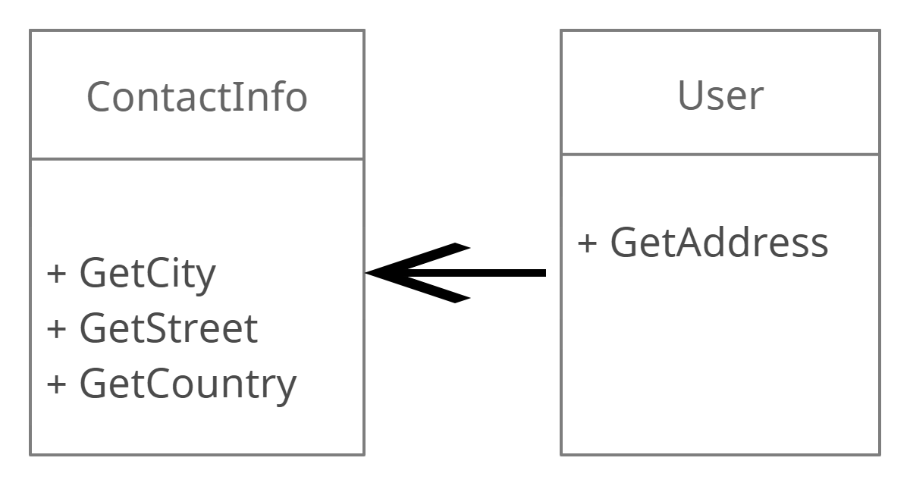
Code Smells Selection Feature Envy
A method that accesses foreign data from another class more than its class.
This method should be moved for better code organization.
Notes:
Our experiments are applied to the feature envy, which is considered one of the most known code smells explored by researchers
Feature envy means that one class uses too many features of another class. This means that most of one class reference something in another class.
The problem with the first situation, and the reason it is considered a code smell, is because it breaks encapsulation.
As a rule of thumb, whenever you find yourself making extensive use of fields from another class to perform any sort of logic or computation, consider moving that logic to a method on the class itself.

Slide 9
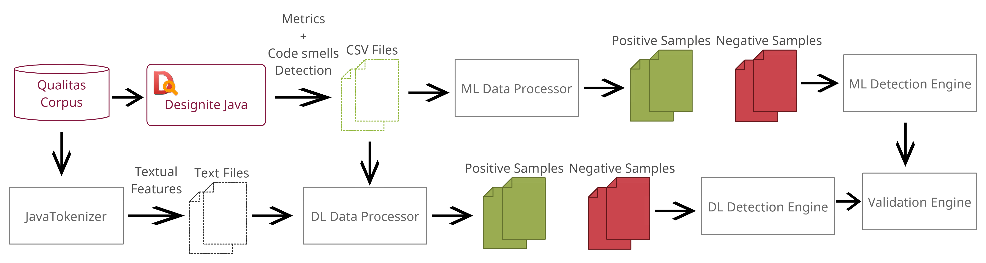
Proposed Detection System
Notes:
The proposed system overview, both ML and DL approaches are applied on open sources java projects from Qualitas Corpus Dataset [33]. In the ML approach, the DesigniteJava tool is used to detect the code smells and extract the corresponding metrics in CSV files, then the data processor module splits the extracted data into positive and negative samples. The ML algorithms are applied to the processed CSVs to train the models and evaluate the classifiers’ performance.
In the DL approach, data will be tokenized by the JavaTokenizer tool which exports tokenized text files. The data processing stage will split the tokenized files into positive and negative samples according to extracted detection information from DesigniteJava. Tokenized data is fed to the DL models to detect the code smells.

Slide 10
Data Preparation
Dataset: Qualitas Corpus is one of the largest benchmark datasets.
Code smells detection: DesigniteJava tool is exploited to compute the metrics values and detect the code smells
Notes:
-Qualitas Corpus is one of the largest benchmark datasets, it is characterized by the composition of different sizes and different domains projects, corpus of heterogeneous 111 Java projects
-DesigniteJava tool is exploited to compute the metrics values and detect the code smells, in addition, the ML and DL classifiers’ results are validated against the results obtained from the DesigniteJava tool.

Slide 11
Machine Learning Approach Data Preprocessing
DesiginiteJava tool is used for code smells detection and metrics extraction, CSVs of metrics and the corresponding code smell are generated.
Data balancing is a key factor for ML classification performance, SMOTE is applied to Feature envy code smell to construct more balanced training data.
Classifier | Dataset |  | Dataset after SMOTE
 | Positive | Negative | Positive | Negative
FE | 790 | 68,658 | 12,640 | 68,658
Notes:
Undersampling: removes instances from the majority class randomly by instances eliminations.
Oversampling: adds instances of the minority class randomly by instances replications.
Synthetic minority oversampling technique (SMOTE): new instances are added to the minority class based on the nearest neighbours belonging to that class. Moreover, SMOTE mitigates the overfitting problem resulting from the random oversampling, in addition, it does not discard potentially meaningful information to build a robust classifier.
SMOTE is applied to FE to construct more balanced training data with around 1/6 smelly samples and 5/6 non-smelly samples, to cope with the code smell dataset with much lower positive than negative samples

Slide 12
Machine Learning Approach ML Algorithms
Eleven ML Classifiers:
Decision Table (DT)
Instance-based learning with parameter k (IBK)
J48
JRip
Multilayer Perception (MLP)
Naïve Bayes (NB)
Random Forest (RF)
Simple Logistics (SL)
Sequential minimal optimization (SMO)
AdaBoost
Bagging
Notes:
Decision Table (DT): the main advantage of applying this method other than the black box ones, is that the rules can be inspected manually.
IBK: lazy supervised learning algorithm that labels the neighbours to each other to the same class.
J48: a decision tree generated by C4.5. At each tree node, the prediction decision is made by the highest gain attribute of information.
JRip: a decision tree that generates a propositional rule learner, the data growing phase and the pruning phase are the two steps which the data training stage split into. In the first step, rules grow greedily by adding conditions until the rule accuracy becomes 100%, after that the second phase prunes each rule.
Multilayer Perception (MLP): an artificial neural network that solves non-linear classification problems, it utilizes the backpropagation technique for training.
Naïve Bayes (NB): makes an assumption that all features are independent and unrelated to each other, and applies the Bayes theorem.
Random Forest (RF): builds more than one tree, each one is concerned with a features subset. Voting is done among all trees to classify the data by choosing the class with the largest number of votes.
Simple Logistics (SL): builds linear logistic regression models for binary data.
Sequential minimal optimization (SMO): this algorithm fixes the quadratic programming problem that arises during the training of SVM, by breaking the problem into smaller sub-problems.
AdaBoost: an adaptive boosting [81], it is the combination of the output of multiple weak learners, the final model depends on the input instances’ weights converging to the strong learner.
Bagging: an ensemble meta-estimator, that builds several classifiers, each on a random subset of the dataset, then aggregates their predictions either by averaging or voting

Slide 13
Machine Learning Approach Training Phase
All classifiers are trained using Weka.
Data is split 70% training set and 30% testing set
Notes:
-Weka is a collection of machine learning algorithms for data mining tasks. It contains tools for data preparation, classification, regression, clustering, association rules mining, and visualization.

Slide 14
Machine Learning Approach Results-Feature Envy
Notes:
-all algorithms fail to get an F-score of 1, RF is the top-performing algorithm while SMO is the worst performing one. Bagging, JRip, and J48 algorithms achieve slightly lower accuracy than RF, according to the results obtained from this study and the previous ones, the decision trees family achieves better performance on code smells due to the ability to extract meaningful rules that describe the code smells properties.
-Variety in precision and recall values has been displayed in Figure 14. All the precision values exceed 0.5, however, the recall values in NB, SL and SMO algorithms demonstrate that these classifiers fail to correctly detect more than half the test samples of FE. This reveals that NB, SL and SMO algorithms are not the best classifiers to detect a code smell like FE.

Slide 15
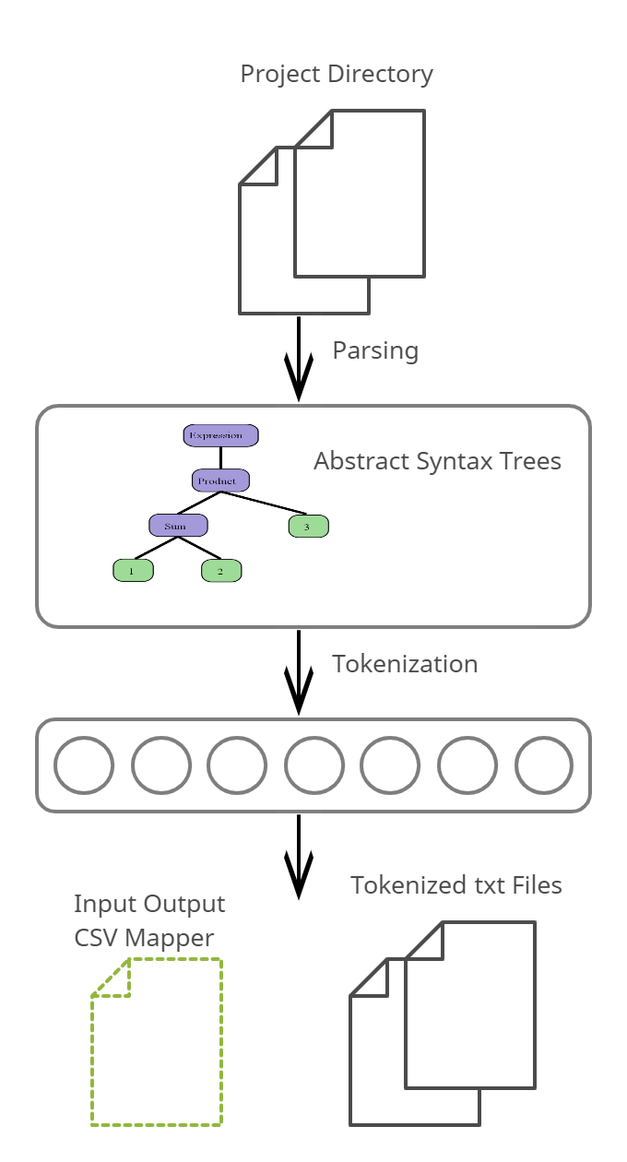
Deep Learning Approach Java Tokenizer
JavaTokenizer tool is an open-source tool based on AST, to extract the textual features from Java source code by transforming tokens into vectors of integers honouring the Java language rules and keywords.
Notes:
49 -> Multi-Granularity Code Smell Detection using Deep Learning Method based on Abstract Syntax Tree
48 -> Code smell detection by deep direct-learning and transfer-learning
-Textual Features Extraction: JavaTokenizer is an open-source tool based on AST, to extract the textual features from Java source code by transforming tokens into vectors of integers honouring the Java language rules and keywords.
JavaTokenizer captures the tokens sequence by iterating on all fields and methods in all classes to pre-assign integer values to them after that tokenize all classes based on the tokens' pre-assignment. This approach significantly captures the data dependencies between all classes in the same project, resulting in improving the detection accuracy for the larger granularity code smells such as feature envy.
-A lack of code tokenization tools, only two tools are available Javalang library [46] and tokenizer [79] that used by [49] and [48] respectively, these are open source tools that tokenize the source code. However, extracting the textual features then applying the same DL techniques achieves different performance on larger granularity code smell FE, as clarified in Table 5, training samples and performance of best classifier and configuration of different textual features extraction tools are listed. The comparison between the JavaLang tool that is based on AST and Tokenizer tool that is based on tokens depends on other factors such as the dataset, however, ignoring the semantic and structural information of the source code results in low accuracy, therefore AST outperforms the token-based approach.

Slide 16
Deep Learning Approach Data Preprocessing
JavaTokenizer tool is used to extract the textual features, the data processing module map each class to its corresponding tokenized file.
Applying SMOTE to FE, more positive samples are generated to become 1/6 from the whole dataset.
Classifier | Dataset |  | Dataset after SMOTE
 | Positive | Negative | Positive | Negative
FE | 628 | 88,063 | 17,612 | 88,063
Notes:
-JavaTokenizer tool is used to extract the textual features, the data processing module map each class to its corresponding tokenized file. Every class suffers from one of the selected code smells is generated in the positive folder other than that it is appended to the negative directory.
-Applying DL techniques on the tokenized source code is very challenging, one of the main challenges is the presence of a large number of features in each class, these values may be extreme at an abnormal distance from other points in the dataset and beyond the expected range, which may result in noise creation affecting the model learning process and generate a complex model and consequently affect the performance negatively. Therefore the outliers that exceed the standard deviation of the data Gaussian distribution are removed to clean the data.
Eliminating outliers reduces the features' dimensionality and thus elaborates the task of applying SMOTE to FE, more positive samples are generated to become 1/6 from the whole dataset, as declared in Table

Slide 17
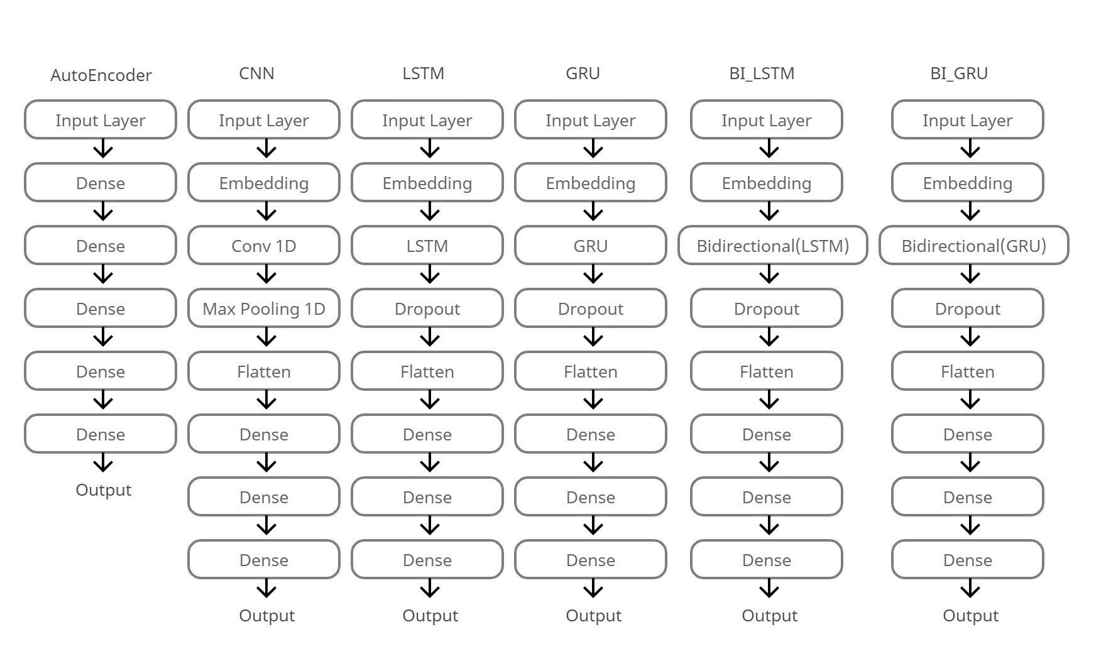
Deep Learning Approach DL Architectures
Six DL architectures are trained.
CNN
LSTM
BI_LSTM
GRU
BI_GRU
AutoEncoders
Notes:
-CNN: A convolution neural network (CNN) is a neural network that is designed to recognize patterns by vectorizing real-world data to detect complex features, it is the most widely used architecture in image, pattern, and speech recognition problems. Recently CNN has proven efficiency in mining text problems
-LSTM: A recurrent neural network variant called Long short term memory (LSTM) proves high efficiency in capturing sequences [84], moreover, LSTM performs better than the traditional RNN from the memorization perspective. this architecture is heavily used in sentiment classification, machine translation, and NLP tasks
-GRU: Gated Recurrent Unit (GRU) is a recurrent neural network, is a variant to LSTM with fewer parameters and a single gate instead of the LSTM forget and input gates [85]. GRU has a simpler structure than LSTM, yet it exhibits better performance on less frequent data, while LSTM performs better on dealing with larger datasets and sequences.
-Bidirectional: Every two hidden layers of opposite direction are connected to the same output by the bidirectional recurrent neural network (BRNN), and hence the output layer learns information from the forward and backward states
-AutoEncoder is a neural network, that encodes input data into vectors, then the decoder stage recreates the compressed data from the bottleneck layer, performing dimensionality reduction to extract new features
-The CNN architecture is inspired by an image classification model, Both LSTM and GRU architectures are inspired by a typical NLP model, we will apply a typical autoencoder model, although there are several variants of autoencoders

Slide 18
Deep Learning Approach Training Phase
All classifiers are trained using TensorFlow and Keras.
Data is split 70% training set and 30% testing set

Slide 19
Deep Learning Approach Results-Feature Envy
Notes:
-The DL architectures results, AutoEconder model performs superior among all classifiers, while the CNN model reports the lowest score
-we observe that AE reports the least precision among all techniques, on the other hand, it gets the highest recall. This means that AE probably fails in capturing all the FE characteristics. Although the other architectures tend to succeed in correctly predicting the positive smelly samples, the recall values show that more than half the instances are predicted correctly.

Slide 20
Results and Discussion
Notes:
-There is a huge diversity in the performance of classifiers in detecting FE. RF has reported the best performance among all ML and DL algorithms.
RQ1: Which classifier among the ML methods performs better?
RF creates many decision trees, each tree is concerned by features subset, therefore the RF algorithm performs features selection that achieves better performance. Therefore it reports the best F-measure among all the ML classifiers.
On average, SMO fails to achieve better results than the rest of the classifiers on the selected code smells classification problem. SMO belongs to the support vector machine family, which creates decision boundaries to separate classes. SMO is a great option for a smaller dataset, on the contrary, it may fail in handling a larger dataset, in addition to its high training time.
RQ2: Are DL methods perform well in detecting code smells compared to the ML methods, and which DL architecture performs superiorly?
Since the autoencoder model reduced features dimensionality, and hence the input data is classified easily, therefore the autoencoder model achieves better performance, then the AutoEconder model performs superior among all DL classifiers. While CNN reports the least accuracy, the traditional neural networks do not pay attention to memorization, moreover, they make an assumption that input and output are unrelated to each other.

Slide 21
Conclusion
This work highlight the following:
Random forest outperforms the other classifiers.
The DL approach is promising and tends to achieve good results compared to the ML approach.
ML and DL techniques have the potential to complement deterministic tools by capturing more nuanced patterns and identifying complex issues.

Slide 22
Future Work
The exterminated techniques will be applied to large scale commercial software projects to generalize our results.
ML algorithms and the DL architectures should be experimented on several setups to select the best configurations to obtain better results

Slide 23

Any Questions
Thank you

